Slide 1
266 Natural Language Processing
Week 10: Embedding-Based Retrieval

Slide 2
This Week
Goals
Understand how to perform semantic retrieval

Slide 3
Peeking Ahead
Week 1: Introduction
Week 2: Text Classification
Week 3: Language and Context
Week 4: Pretrained Transformers
Week 5: Text Generation Models
Week 6: Machine Translation
Week 7: Question Answering & Summarization
Week 8: Linguistic Representation
Week 9: Entities and Linking
Week 10: Embedding-based Retrieval
Week 11: Multimodality in NLP
Week 12: ML Fairness and Privacy
Week 13: NLP in the Real World

Slide 4
Announcements
Assignment 4 (MM) - released Friday 02/27
  Due Sunday 03/24 (Tuesday 03/26 if you use late days)
  Final assignment
Project -
  Feedback complete (assume you can start working)
  Projects - Due Saturday 04/14 (hard deadline)
  Optional milestone - 03/18
  4 - 5 WEEKS
  Questions?
Concerns?

Slide 5
Announcements
Paper reading sessions:
  Unlocking Practical Applications in Legal Domain: Evaluation of GPT for Zero-Shot Semantic Annotation of Legal texts
    Mark: Tuesday 03/12 5:30 PST
  LLM Efficiency Crash Course
    memory efficiency: quantization: LLM.int8(): 8-bit Matrix Multiplication for Transformers at Scale
    model inference efficiency: SPEED: Fast Inference from Transformers via Speculative Decoding
    system level inference efficiency: Flash-decoding for long-context inference
    Peter: Tuesday 03/19 Noon PST
Concerns?

Slide 6
The Plan
Structure of Class
Key Learning Review
Ranked Retrieval
  Tokenization and Ambiguity
  Learning to Rank
Neural IR
  Two tower model for QA
Evaluation
Retrieval Augmented Generation (RAG)

Slide 7
Key Learnings Review
Embedding-Based Retrieval

Slide 8
NLP Review
What are the advantages and disadvantages of static word embeddings?
What are 3 pre-trained Transformer models and their differences?

Slide 9
Ranked Retrieval
Embedding-Based Retrieval

Slide 10
Representations and Relevance in IR
BOW approach
Represent document(s) and query as sparse vector of words with scores
tf*idf is exemplar
Relevance is a function of word frequencies in and across docs
Semantic approach
Create dense vector representation of documents and query
Latent space captures semantic relations between all words
Relevance is a function of location in shared latent space

Slide 11
Why rank?
Unranked Search
Return a large unsorted collection of docs that match the query
Does the user have to look at all docs to meet their information need?
Ranked retrieval
Return sorted collection of docs that match the query from most to least “relevant”
Let user keep reading down ranked list until their information need is met
Relevance ranking is central to modern information retrieval

Slide 12
Tokenization and Ambiguity
Embedding-Based Retrieval

Slide 13
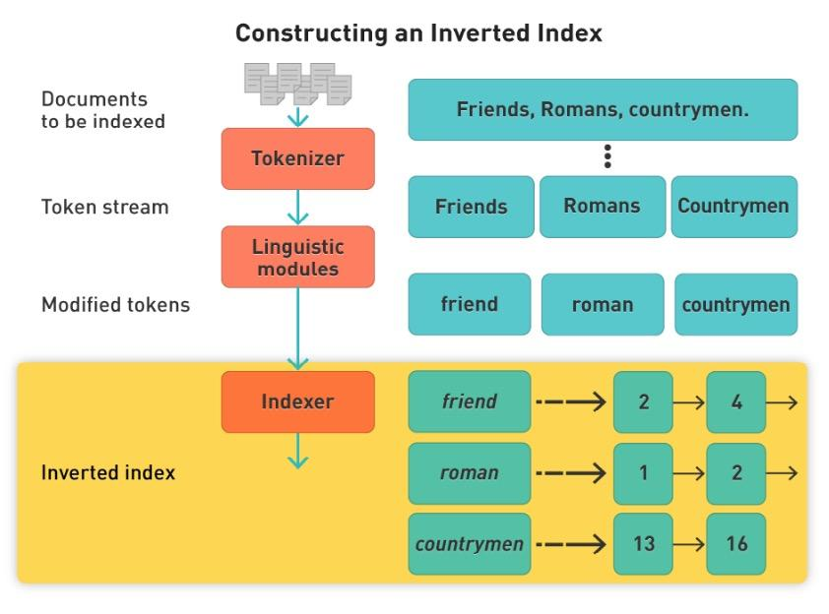
IR: Tokenization and Inverted Index
Like a back of book index - words/phrases point to list of page numbers
Query terms must match index keys
Query and index get identical pre-processing
Index keys can match tokens or multi-token annotations
Notes:
Need to construct in a distributed manner too!

Slide 14
Ambiguity and Tokenization
Homonyms
Lincoln: President? Car Make? Place in Nebraska?
Word Senses
  Fly.noun: Insect? Fly.verb: Move through air?
Synonyms
throat: esophagus
IBM: International Business Machines
What is the information need?
How can we mitigate the problem of ambiguity?
What kinds of representations can we leverage?
Sampling-Bias-Corrected Neural Modeling for Large Corpus Item Recommendations (https://storage.googleapis.com/pub-tools-public-publication-data/pdf/6c8a86c981a62b0126a11896b7f6ae0dae4c3566.pdf)
Notes:
stemming

Slide 15
Ranking by Words: tf.idf
Term Frequency (TF):
The number of times each query token appears in the document
Proxy: How relevant is this document to this word?
Inverse Document Frequency (IDF):
log N/n_{t}
Proxy: Balance between words
Notes:
IDF proxy is “how informative is this word, overall?”
N = total number of documents
n_t = number of documents that contain term t
True/false?
“If N=n_t, then N/n_t = 1”
If A=B, then A/B=1
If

Slide 16
Ranking: tf.idf
[hello]
IDF(hello) = 0.1
Doc 1 TF: 6
Doc 2 TF: 8
Does IDF matter?

Slide 17
Ranking: tf.idf
[hello]
IDF(hello) = 0.1
Doc 1 TF-IDF: 6*0.1 = 0.6
Doc 2 TF-IDF: 8*0.1 = 0.8
Does IDF matter?

Slide 18
Ranking: tf.idf
[hello world]
IDF(hello) = 0.1
IDF(world) = 8
Doc 1 TF(hello): 20, TF(world): 0
Doc 2 TF(hello): 1, TF(world): 1
Does IDF matter?

Slide 19
Ranking: tf.idf
[hello world]
IDF(hello) = 0.1
IDF(world) = 8
Doc 1 TF(hello): 20, TF(world): 0
TF-IDF(hello)=20*0.1=2 TF-IDF(world)=0*8=0
Doc 2 TF(hello): 1, TF(world): 1
TF-IDF(hello)=1*0.1=0.1 TF-IDF(world)=1*8=8
Does IDF matter?

Slide 20
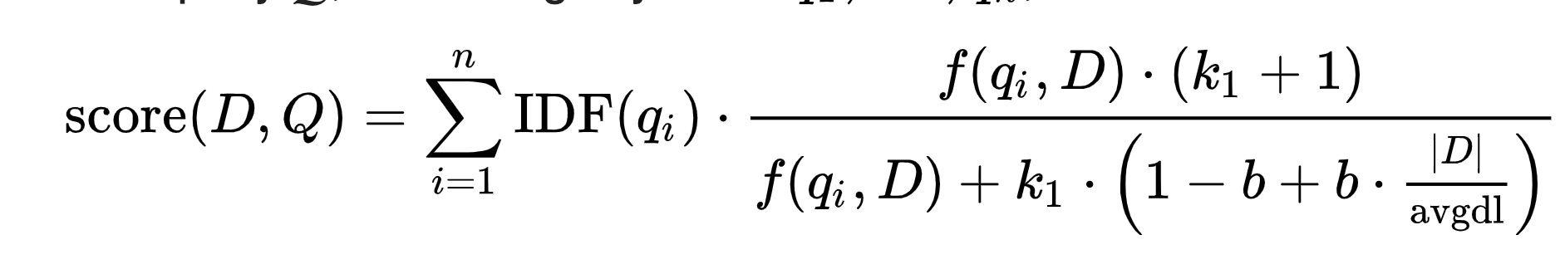
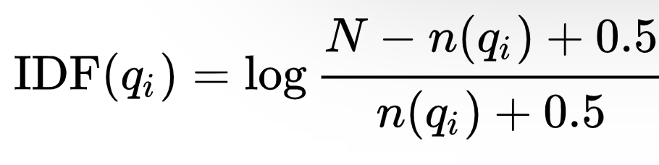
Ranking: Better tf*idf
Okapi BM25 - Length normalized tf*idf, often a very strong baseline
k1 and b are tunable parameters
|D| is document length and avgdl is average document length in corpus
N is the total number of documents in the collection
Calculated term by term - no phrases
Source: Wikipedia article on BM25 ranking algorithm
Notes:
Good defaults: 1.2 < k < 2.0; b=.75 Christopher D. Manning, Prabhakar Raghavan, Hinrich Schütze. An Introduction to Information Retrieval, Cambridge University Press, 2009, p. 233.

Slide 21
Neural Information Retrieval
Embedding-Based Retrieval

Slide 22

Two Tower Recap
A two tower network is just a single tower with internal network connections removed to partition the features into two separate processing paths.
To construct one…
Start with a normal prediction problem (objective, training data, etc)
Partition the network.
Does using a two tower model for retrieval eliminate the need for thinking through what you’re optimizing for?

Slide 23
Two Tower Recap
Critical insight: Decouple indexing and query processing flows in the neural network.
What do you gain?
What do you lose?

Slide 24
Two Tower Recap
Critical insight: Decouple indexing and query processing flows in the neural network.
Gains: You can take advantage of the decoupling (see the next slides!)
Drawback: The features into both towers have little opportunity to interact. Post-retrieval scoring is still necessary.

Slide 25
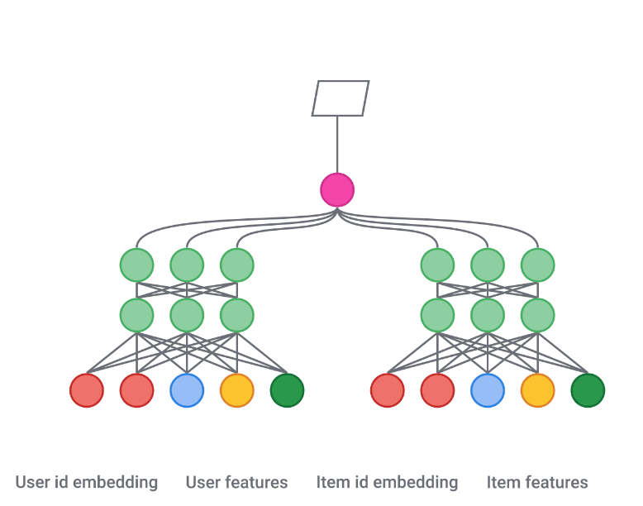
Two Tower Recap
Critical insight: Decouple indexing and query processing flows in the neural network.
Gains: You can take advantage of the decoupling (see the next slides!)
Drawback: The features into both towers have little opportunity to interact. Post-retrieval scoring is still necessary.
Query
Document

Slide 26
Two Tower Advantages
Address shortcomings of token based retrieval - a mechanism to allow us to run deep learning models to better understand queries and documents
Why can’t we just run a regular/single tower neural network?
Hint: do we actually care about the relevance prediction for every document in the corpus?

Slide 27
Two Tower Advantages
Address shortcomings of token based retrieval - a mechanism to allow us to run deep learning models to better understand queries and documents
Solve the problem we actually care about - retrieving a collection of high quality candidates upon which to run more expensive models. (i.e. if a document in the corpus is really low relevance, spend as little time on it as possible!)
Efficient: run the indexing tower O(docs) times, in advance, and use that for all incoming queries.
What real world problems can take advantage of this approach?

Slide 28
Two Tower Applications
Used in a number of retrieval applications:
Information Retrieval: Index web documents, retrieve on query
Entity Grounding: Index named entities, retrieve based on passage of text.
Recommender systems:
  Index candidates, retrieve with user signals
  Index users, retrieve based on a new candidate to proactively inform them

Slide 29
Evaluation Metrics
Embedding-Based Retrieval

Slide 30
Ranked Retrieval Evaluation
How do we evaluate?
True: sorted list of (document, relevance)
Predict: sorted list of (document, predicted relevance)
Need to do ranking comparison! Many choices:
Mean Average Precision (MAP)
Normalized Discounted Cumulative Gain (NDCG)
Kendall’s Tau, Spearman’s Rho

Slide 31
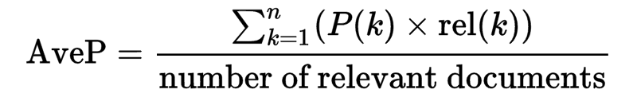
Mean Average Precision (MAP)
Mean Average Precision ~= AUCpr
Idea: average precision for retrieving each relevant document
MAP = average of AvpP over all queries
Notes:
where
k is the rank in the sequence of retrieved documents,
n is the number of retrieved documents, {
P(k) is the precision at cut-off k in the list (so … from i=1,2,...,k)
rel(k) is an indicator function equaling 1 if the item at rank k is a relevant document, zero otherwise.
Note that the average is over all relevant documents and the relevant documents not retrieved get a precision score of zero.

Slide 32
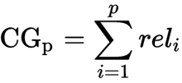
Cumulative Gain
Sum of relevance scores for documents 1… p
Problems?
Notes:
Problems: doesn't pay attention to order or returned results and it also unnormalized (different queries will have different maximum values)

Slide 33
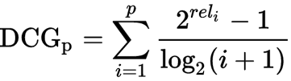
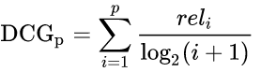
Discounted Cumulative Gain
There are two common formulations of this...
Rank normalized sum of relevance scores for documents 1...p
Problems?
Notes:
Good: Order matters, now
Problems: Still unnormalized across queries (/different queries will have different maximum values)

Slide 34
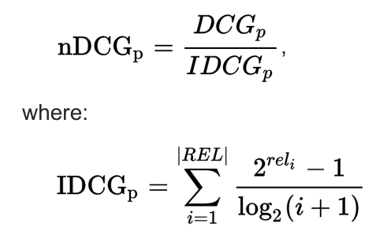
Normalized Discounted Cumulative Gain
REL represents a perfectly ordered list of relevant documents in the corpus up to retrieval position p.
IDCG_{p} is the maximum DCG_{p} score, achieved by the perfect ordering.

Slide 35
Rank Correlation
Kendall’s Tau: pairwise ordering accuracy
Consider all pairs (x_{i}, x_{j}) with scores y_{i}, y_{j}
𝝉 = (# pairs correctly ordered - # pairs incorrectly ordered)
(# total pairs)
Normalized difference between correctly vs. incorrectly ordered document pairs.
Notes:
Over all pairs, not just adjacent ones. Thus the denominator is N choose 2.

Slide 36
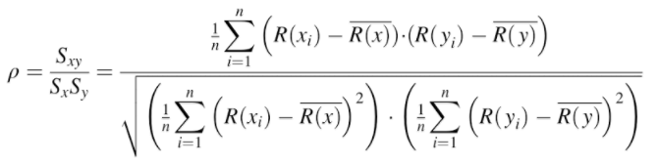
Rank Correlation
Spearman’s Rho: rank correlation
Rank true scores, predicted scores
Compute Pearson correlation between lists of ranks
Ex: true = [1,2,3,4], pred = [3,2,1,4]

Slide 37
Notebook Walkthrough
Two tower examples: NewsHeadlines, MovieLens

Slide 38
Ok, but before we split things into separate towers, how do we set up a ranking problem as a NN anyways?

Slide 39
Neural Architectures
Embedding-Based Retrieval

Slide 40
Neural IR models - Two Approaches
Relevance models learn to score (long) documents by (short) queries
Focus on producing a relevance score for each doc relative to the query
Build representations focused on term relevance
Semantic similarity models score text pairs by meaning similarity
Focus on longer natural language queries/questions.
Build representations focused on semantic meaning.

Slide 41
Neural IR models - Representations
Query representations
Query is a short low dimensional vector (like embeddings)
Document representations
Do we represent sentence(s), passage(s), or document as low dimensional vector?
Ranking/Relevance representations
Relevance as a probability (e.g. P(D|q) or P(q|D)

Slide 42
Learning to Rank Example

Slide 43
Deep Relevance Matching Model (DRMM)
Introduces Relevance Matching function:
Exact matching signals - term occurs in query AND doc
Calculate term importance in queries
Diverse matching - relevance match can occur anywhere in the document
Contrasts with Semantic Matching:
Semantic similarity (doc and query are semantically similar)
Meaning of overall chunk of text rather than set/sequence of words
Globally match whole doc to query
Adapted from Guo et. al., 2016, A Deep Relevance Matching Model for Ad-hoc Retrieval

Slide 44
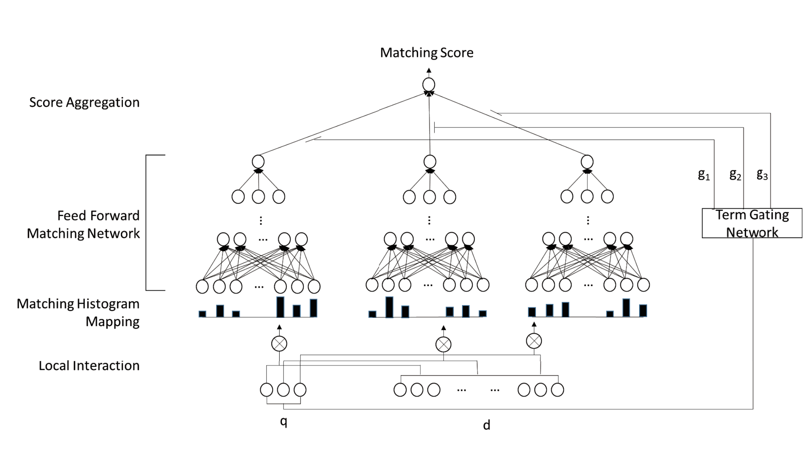
DRMM structure
Word2vec embeddings for doc and query terms minus stopwords.
Each query term compared to all doc terms to construct a matching histogram.
Histogram fed to FFMN to produce query term score
Gating function rates query terms in importance to “relevance”
Query term scores aggregated to produce relevance score
Adapted from Guo et. al., 2016, A Deep Relevance Matching Model for Ad-hoc Retrieval

Slide 45
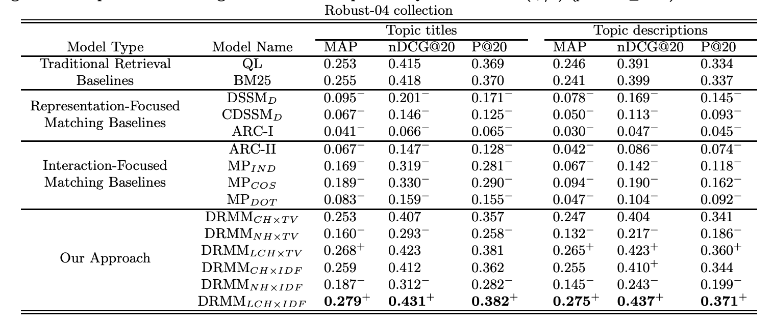
DRMM Results
Some improvement over BM25 baseline for count histogram and log-count histogram.
Fundamentally a BOW model!
Adapted from Guo et. al., 2016, A Deep Relevance Matching Model for Ad-hoc Retrieval

Slide 46
Semantic Similarity Example

Slide 47
USE-Semantic Retrieval
Extension of Universal Sentence Encoder
  (“Universal Sentence Encoder”, Cer et al, https://arxiv.org/pdf/1803.11175.pdf)
Seeks to create latent semantic space into which docs and queries can be mapped
Trained on multiple tasks
  conversation response prediction
  Quick Thought
  Natural language inference (NLI)
  bilingual text retrieval
Tested on a semantic retrieval task
  Identify all sentences in retrieval corpus that are semantically similar to a query sentence
Adapted from Yang et. al., 2019, Multilingual Universal Sentence Encoder for Semantic Retrieval

Slide 48
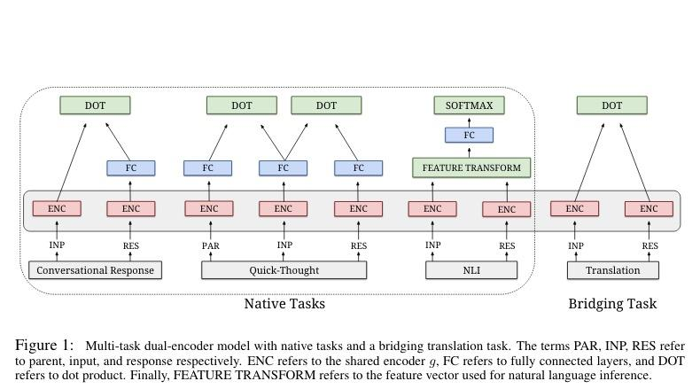
Universal Sentence Encoder (USE) Family
Dual Encoder Architecture
Two encoders with shared parameters learn to produce representations (sentence embedding) that maximizes similarity (dot product) between dual encoder outputs.
Based on Chidambaram et. al., 2019, Learning Cross-Lingual Sentence Representations via a Multi-task Dual-Encoder Model

Slide 49
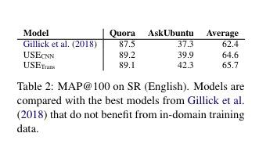
USE - Semantic Retrieval Results
Fine-tuned on large sets of question answer pairs.
Identify different questions that have the same answer:
What is your age?
How old are you?
These are semantically similar.
Query on one should retrieve all others
Adapted from Yang et. al., 2019, Multilingual Universal Sentence Encoder for Semantic Retrieval

Slide 50
Retrieval-Augmented Generation (RAG)

Slide 51
The Problem(s)
Retrieval Systems
  Return docs that contain my questions answers but don’t answer my questions
LLMs
  Write beautiful answers to questions but make stuff up
  Trained on older data
  Not trained on my company’s data
How can I solve these problems?

Slide 52
A Solution
User Question
Search System
Passes highly relevant retrieved info plus prompt
Strength: good context + prompt = great at generating answer
Strength: Index latest domain specific information
Large Language Model
Answer for User

Slide 53
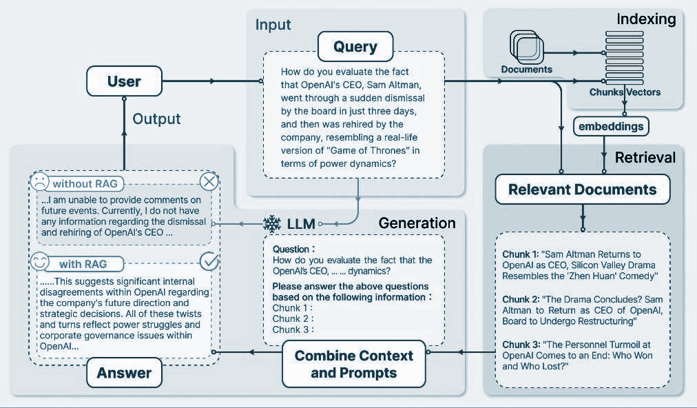
Retrieval Augmented Generation
Source: Retrieval-Augmented Generation for Large Language Models: A Survey

Slide 54
Paper Peeks/Recent Advances/Challenges
Embedding-Based Retrieval

Slide 55
Papers
Very good overview and dataset for evaluating retrieval systems
  BEIR: A Heterogeneous Benchmark for Zero-Shot Evaluation of Information Retrieval Models (Thakur et. al. 2021)

Slide 56
Extras
Embedding-Based Retrieval

Slide 57
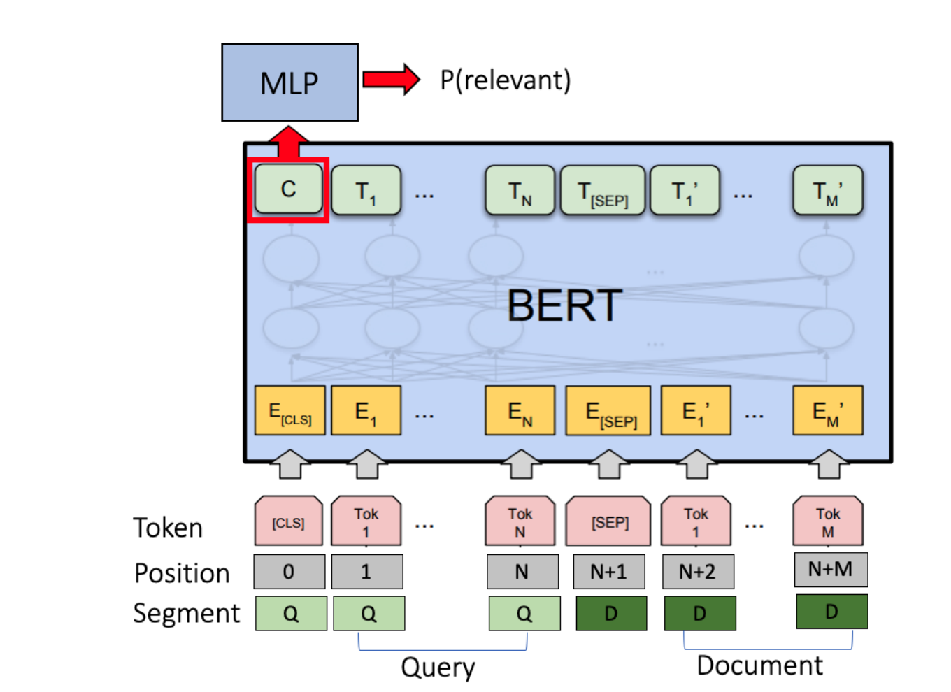
IR using BERT
Simple adaptation of BERT
[CLS] as sentence or passage vector
Binary relevance classifier
Doc relevance based on passage level scoring
  First passage, Max passage, Sum Passage
Fine-tuning on query logs
Question: Is this a relevance match model or a semantic match model?
Based on Dai and Callan, 2019, Deeper Text Understanding for IR with Contextual Neural Language Modeling

Slide 58
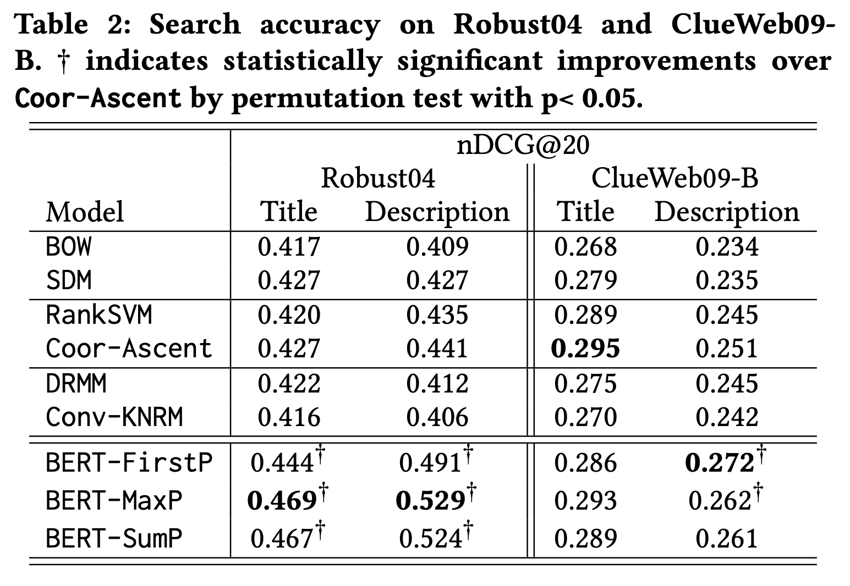
IR using BERT
Does BERT help retrieval?
  Seems better on natural language queries
  Stopwords are a problem in tf*idf but mark key semantic relations
  Where are wind power installations located? There are 1200 wind power installations in Germany.
BERT language model captures “language understanding” - fine-tuning on query/doc pairs adds “search knowledge.”
Based on Dai and Callan, 2019, Deeper Text Understanding for IR with Contextual Neural Language Modeling

Slide 59
ScaNN - https://ai.googleblog.com/2020/07/announcing-scann-efficient-vector.html
TF Recommenders - https://blog.tensorflow.org/2020/09/introducing-tensorflow-recommenders.html

